Slide 1

CAPSTONE PROJECT VoIP TESTING ACROSS WAN
PRENSENTED BY
LATISHA S -192524071
MOUNNILA S P-192511188
KUNATI SAI LIKHITH-192524247

Slide 2

CONTENTS
INTRODUCTION
WHAT IS VoIP AND WAN
PERFORMANCE OF VoIP OVER WAN
EVALUATION OF VoIP
TESTING OF VoIP PERFORMANCE
METHODS OF TESTING VoIP
CALL QAULITY USING VoIP
ANALYSIS OF VoIP USING ASTERISK AND SIP

Slide 3
Introduction
Overview of VoIP
Overview of WAN
Role in WAN in VoIP Communication
testing and evaluation of VoIP
tools and methodologies- Asterisk and SIP

Slide 4
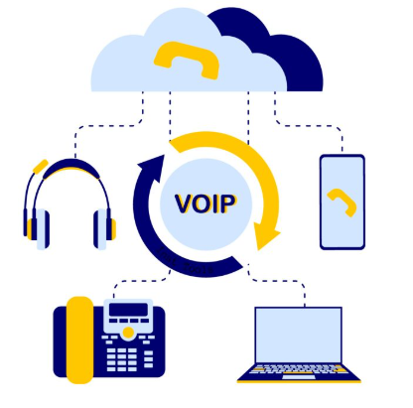
What is VoIP and WAN
VoIP (Voice over Internet Protocol)
Transmits voice over IP networks
Converts voice into digital packet
Supports voice, video, messaging
Common apps: Skype, WhatsApp, Zoom, MS Teams.

Slide 5
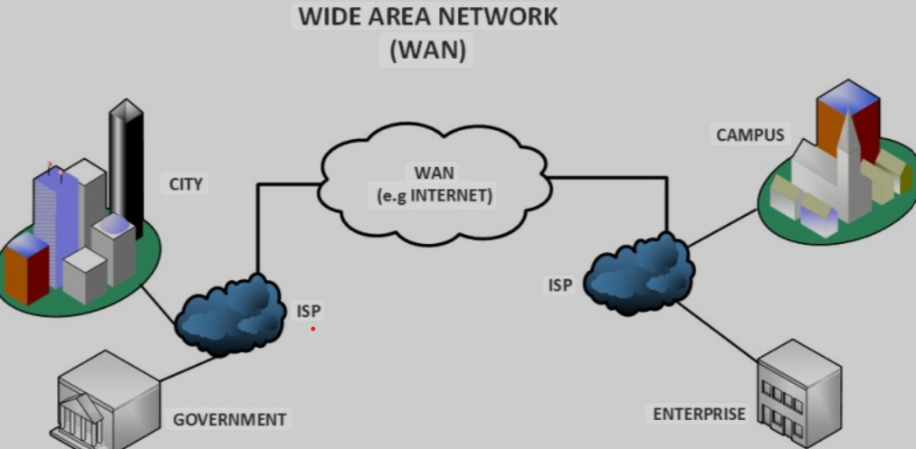
A Wide Area Network (WAN)- large geographical area
It connecting multiple LANs or
other networks VoIP
Used in business ,governments,educational institutions
and ISPs
Can span cites or even countries
WAN (wide area network)

Slide 6
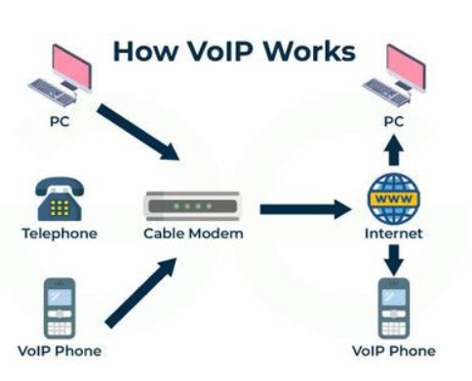
Performance of VoIP over WAN
VoIP performance – WAN(eg; city to city)
Ensure Enough bandwidth for voice data
QoS -essential to prioritize VoIP traffic in WAN
Use Routers, firewalls, jitter &buffers-improves performance.
Consistent testing & optimization- needed for reliable VoIP over WAN.

Slide 7
Evaluation of VoIP
Ensure call clarity and stability
Detect and fix issues like jitter, latency, and packet loss
Validate network readiness for voice traffic
Confirm QoS (Quality of Service) policies work
Benchmark performance under load (stress testing)

Slide 8

VoIP Testing
Verifies quality and reliability of voice over IP
Ensures smooth call setup, voice clarity, and no delay or drop.
Measures important parameters like:
Latency – delay in voice delivery.
Jitter – variation in packet arrival.
Packet Loss – missing voice packets.
MOS (Mean Opinion Score) – voice quality rating from 1 to 5.
Echo – hearing your own voice back.

Slide 9

Methods for Testing VoIP
Method | Purpose | Tools Used | Key Parameters / Metrics
1. Functional Testing | To verify VoIP features and basic operations | SIPp, Softphones (Zoiper, Linphone) | Call setup, teardown, hold, transfer, voicemail
2. Performance Testing | To test system under load and network stress | SIPp, Wireshark, VoIPmonitor | Jitter, latency, packet loss, call drop rate
3. QoS Testing | To evaluate perceived call quality | PESQ, P.563, VoIP Spear, VoIPmonitor | MOS (Mean Opinion Score), R-Factor, echo, delay
4. Network Testing | To test underlying network’s capability to support VoIP | Iperf, PingPlotter, NetStress, Wireshark | Bandwidth, jitter, latency, packet delivery

Slide 10
Methods for Testing VoIP
Method | Purpose | Tools Used | Key Parameters / Metrics
5. Security Testing | To identify vulnerabilities and threats | SIPVicious, Wireshark, Metasploit | SIP flooding, eavesdropping, spoofing, encryption
6. Compatibility Testing | To ensure compatibility across devices and updates | Manual tests, Softphones, PBX systems | Device support, firmware compatibility, stability
7. Regression Testing | To confirm changes don’t break existing functionality | Automated scripts, SIP test tools | Pre- and post-change behavior comparison

Slide 11
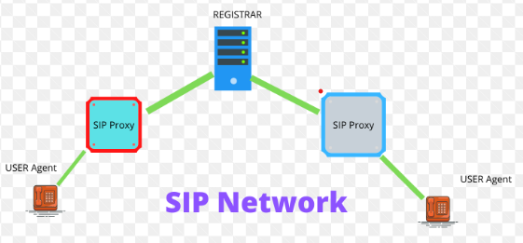
SIP Protocol and Its Impact on Performance
The Session Initiation Protocol (SIP) -setting up, managing VoIP calls.
SIP signaling- controlling & multimedia communication -voice and video
Enhance user experience across WAN.

Slide 12

Analyzing Call Quality Using Asterisk
Asterisk (open- framework)- building communications application
Used for VoIP implementation
users - control and analyze call quality.
proactive management -standards are consistently met.

Slide 13
Conclusions
The evaluation of VoIP performance in WAN environments is essential for delivering high-quality communication. By focusing on key metrics, utilizing appropriate testing tools, and understanding the roles of Asterisk and SIP, organizations can ensure reliable VoIP services. Continuous performance assessments foster proactive management, leading to improved call quality and user satisfaction.

Slide 14
Thank You!

